Slide 1
Week 3:
Bose and Dao

Slide 2
Deliverables
Improve our graphs by incorporating established research best practices, such as including a dotted baseline and adding clear, impactful takeaway statements.
Add metrics for EPS, PE, and Dividend to see which metric is the most informative
After finding the most important metric, randomize the quantity of stock
Literature review with surveys of portfolio optimization

Slide 3
Parameters (Review)
Initial Budget: $10,000
Strategies
Buy and hold (benchmark)
Random number of stocks
Random stock selection
Random portfolio composition
Random dollar cost averaging
Metrics
Complete random
Long-term investing

Slide 4
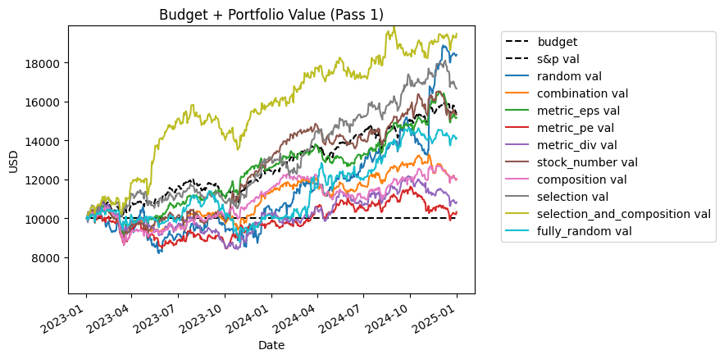
Strategy Returns
The selection and composition strategy established extreme dominance almost immediately, soaring to nearly an 83% return and vastly outperforming all other methods.

Slide 5
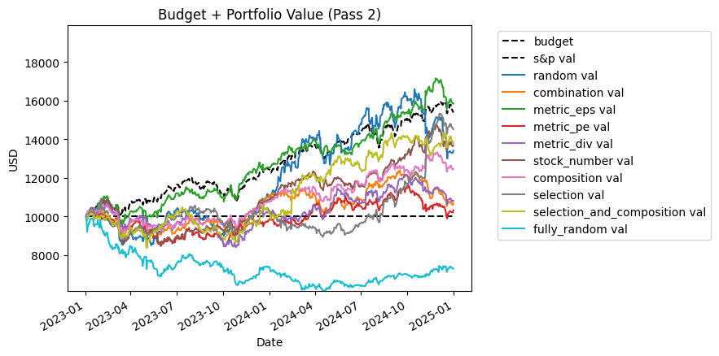
Strategy Returns
While the standalone Selection strategy regressed somewhat in this block, the metric EPS showed to perform above the SP500 for the most part.

Slide 6
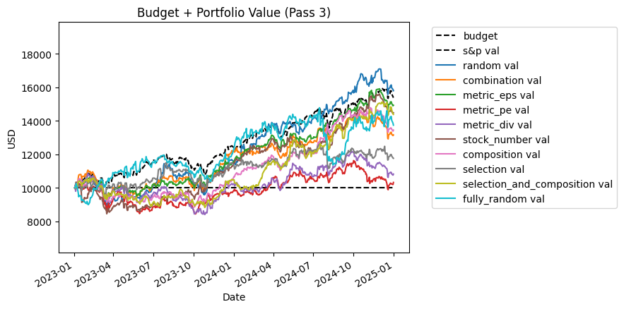
Strategy Returns
In this iteration, all versions performed near to the baseline.

Slide 7
Metric Performance and Graph Takeaways
Within 3 runs of random,
Metric EPS: ~20.8 percent return
Metric PE: ~ 10.4 percent return
Metric Dividend Yield: ~ -14 percent return
These values obviously can easily change with each random run, but we see that Metric EPS seems to be the most important metric.

Slide 8
Choosing EPS
After discovering that EPS was the most vital deterministic metric, we wanted to randomize the number of stocks that we chose while focusing on EPS as the most important metric. Instead of forcing exactly n=5 stocks to be selected on every rebalance cycle, the new randomized eps strategy dynamically picks a random quantity of top EPS stocks [1-10] on each rebalance day.
We did 3 passes once again.

Slide 9
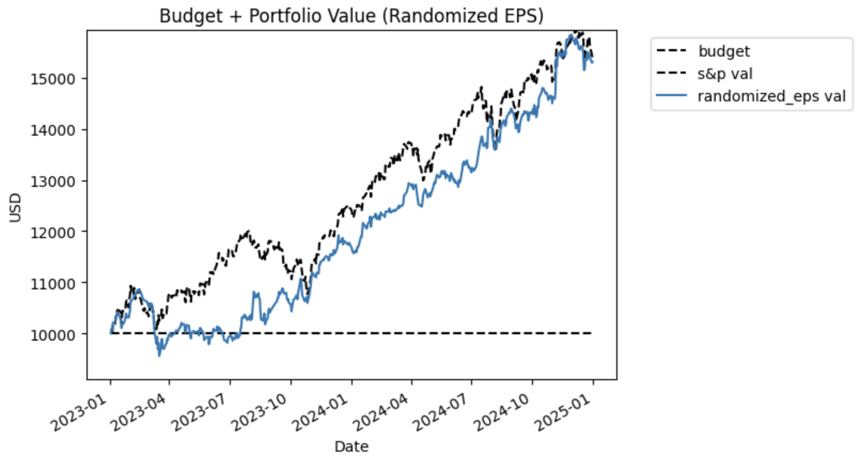
EPS Returns
The randomized strategy performed well here, with a ~53% return, showing high upside potential when the randomizer selects an optimal quantity of top EPS stocks.

Slide 10
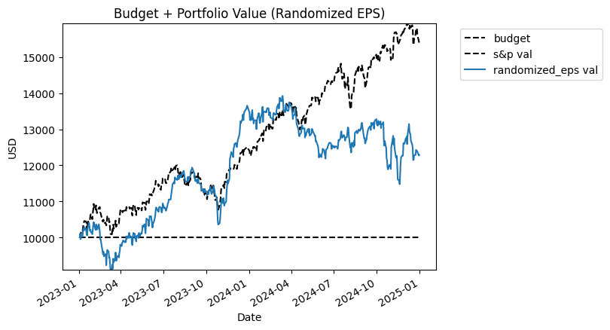
EPS Returns
Performance significantly degraded to ~22% in this pass. It underperformed the S&P 500 but still protected the initial budget and returned a positive yield.

Slide 11
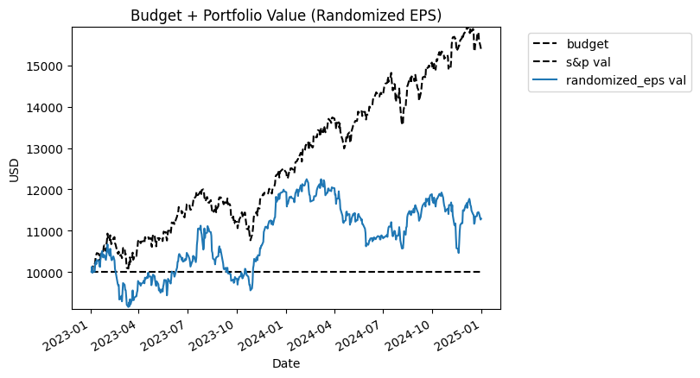
EPS Returns
The portfolio struggled with only a ~12.8% return. This highlights the stark inconsistency and high volatility of randomly bounding stock quantities, heavily restricting the upside even when the underlying selection metric (EPS) is strong.

Slide 12
Portfolio Optimization Literature Review
Several methods depending on type of portfolio: defensive, aggressive, income, hybrid, speculative
Mean-variance optimization: assesses risk through covariance of asset returns for given returns or risk
Conditional value at risk returns: estimates potential loss over specific timeframes of individual assets
Reinforced learning & Long short-term memory models: learning innate dependencies and extracting features over time
Swarm methods (e.g, firefly, ant colony, beehive): randomly generates a population of sample portfolios and has them ‘move’ towards optimal ones (can also specify cardinality)

Slide 13
Limitations
Classical methods are limited by how much information they can analyze (especially for dynamic methods)
Dependence on historical methods (especially for some less complex methods like mean-variance) lead to overfitting
High-dimensional search spaces can be much more easily navigated by the quantum methods
Early testing by firms like IBM and HSBC has shown quantum methods can outperform classical yields

Slide 14
Quantum methods
Quantum tabu search: local search algorithm using qubits to prevent overfitting with its own custom fitness function. Has yet to be applied in finance but has great potential (https://arxiv.org/pdf/2404.13203)
Quantum swarm optimization: quantum principles can guide optimization algorithms for swarm algorithms like cat swarm (https://arxiv.org/abs/2402.16863#:~:text=The%20Quantum%2Dinspired%20Chaotic%20Salp%20Swarm%20Optimization%20(QCSSO),Improve%20population%20diversity%20*%20Speed%20up%20convergence)
Quantum evolutionary algorithms: balances convergence speed and parallel search capability (https://arxiv.org/html/2601.11029v1)

Slide 15
Final Notes
Causal analysis
Quantum portfolio composition (should we stick with composition?)
Future approach to work and presentation (how should we test things independently?)
ID card access

Slide 16
Notes from 3/23
Fix the quantity. N = 1
If you can’t buy 10, then don’t buy
EPS, dividend, PE and we want to see which metric is the most informative
After we find the most important metric, then randomize the quantity of stocks
Find survey of portfolio optimization to read. Then we can find newer methods later
Bandit methods(a form of reinforcement learning)
Recommendation paper that Dr. Biplav will send. Papers at the intersection of learning and search
Only really consider papers that we can replicate and implement ourselves.
Update all of the lines. Add punchlines and also make the baseline in black and dotted lines.

